Slide 1
Modeling Natural Mortality in Stock Synthesis

Slide 2
M options in Stock Synthesis
Single value for all ages
Broken stick (piecewise linear) where the number of breakpoints can be set
Scaled Lorenzen curve where the curve is scaled to an estimable value at a given age
Age-specific vector of user-specified fixed values

Slide 3
Broken stick

Slide 4
Broken stick
Age zero
Zero exponential offset

Slide 5
More on Mortality
Value for males can be as offset from females
Can be time-varying like other parameters
If broken stick is used (piecewise linear), values before and after range of breakpoints are constant at first/last value

Slide 6
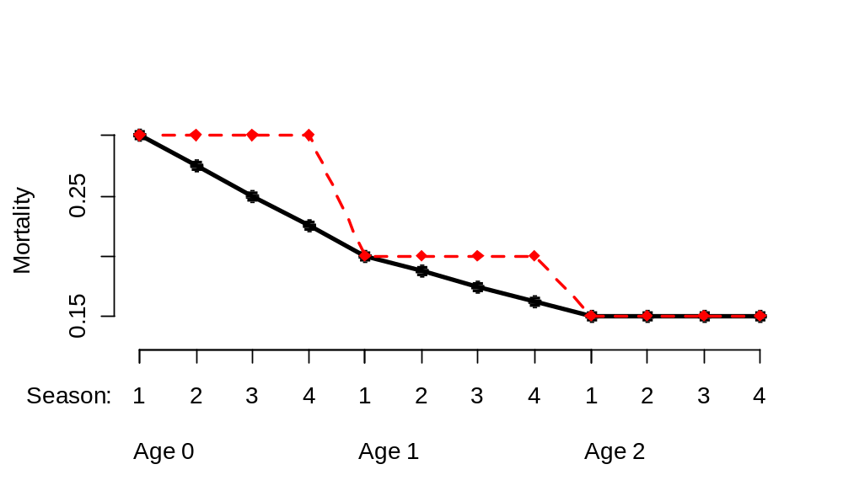
Mortality in seasonal models
Mortality is function of real age based on birth season, not calendar age
User-specified values have choice of same value for each season within year, or interpolated values for each season

Slide 7
Lorenzen mortality
Mortality is a function of mean size at age
Parameter for M at user-specified reference age
Based on initial growth curve, so does not work well with time-varying growth

Slide 8
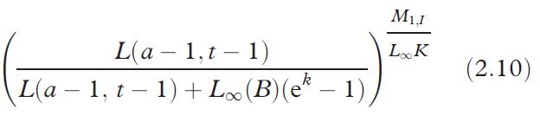
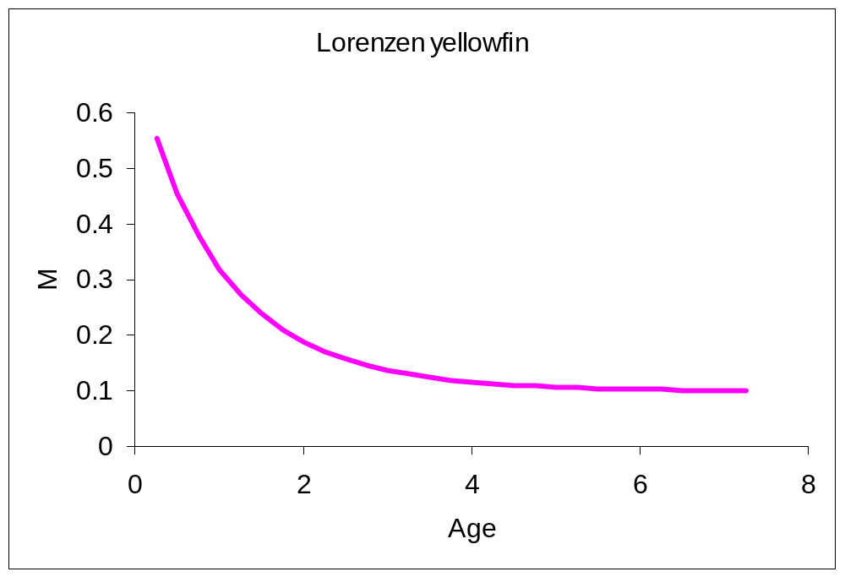
Lorenzen mortality
S =
Lorenzen, K. (2005) Population dynamics and potential of fisheries stock enhancement: practical theory for assessment and policy analysis. Philosophical Transactions of the Royal Society Series B, 360:171-189.

